Slide 1

Mini Project Report
GLA FOOD ORDERING APP
~ Mohd Aqib
~ Suyash Batham
~ Mridul Srivastava
~ Akash Gupta
~ Prajesh Srivastava

Slide 2
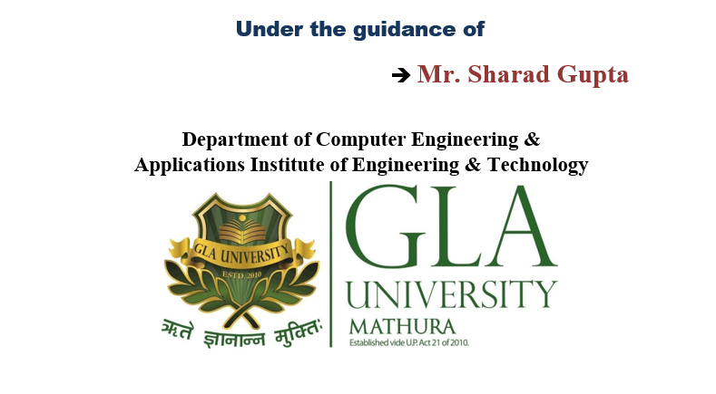
Food Ordering Application

Slide 3

Introduction
Online food delivery service is gaining its ground and reaching its peak.
Simplicity : People admire online food delivery service because of its simplicity and transparency.
Wide Variety: The online menu provides an option for the user to select from various restaurants.
Offers : Everyone loves an offer from their favorite restaurant. An offer not only attracts users but also promotes the restaurant.

Slide 4
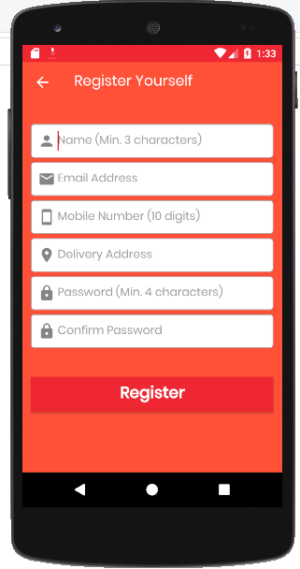
About Application
Our Application is user
friendly which contains
many options which
make easy to use for consumers.

Slide 5
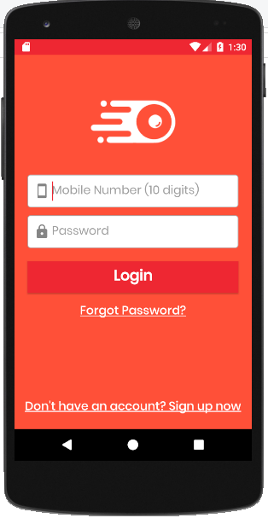
Log In System

Slide 6
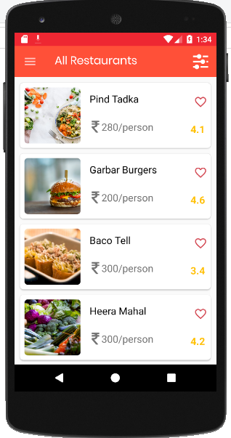
Home Page

Slide 7
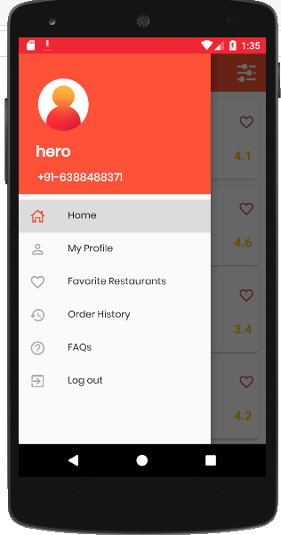
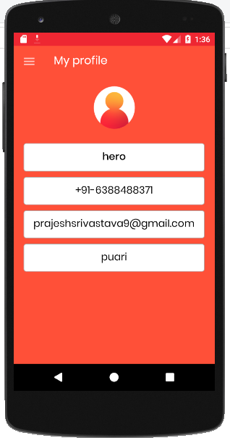
My Profile

Slide 8
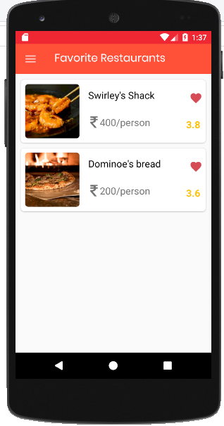
Favorite Restaurants

Slide 9
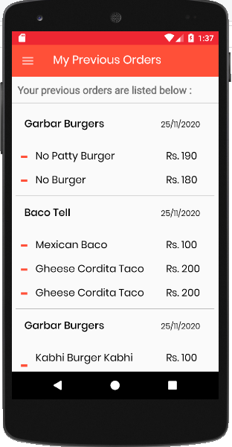
Order History

Slide 10
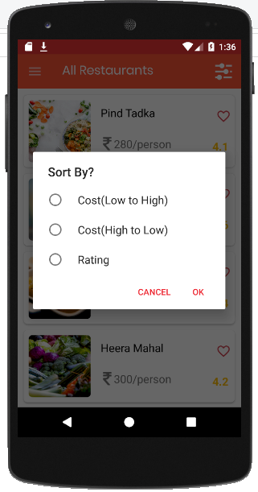
Sort by..

Slide 11
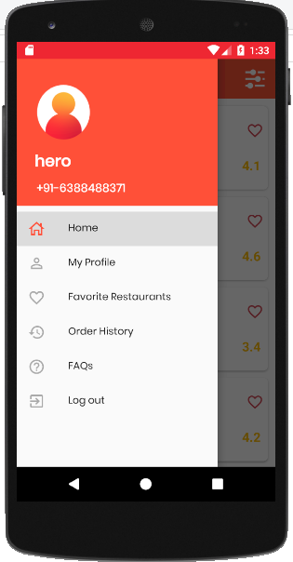
Logout

Slide 12
Important Links
Github repository:
https://github.com/mohdaqib129/Gla-Food-Ordering_App
Working presentation video:
https://drive.google.com/file/d/19PWV2kGDii0wbFxMVoSH93euvZkd4RQj/view

Slide 13
RESOURCES
SUMMARIZE PROJECT RESOURCES
Udemy
YouTube
Geeks for Geeks
JavaTpoint.com
Provided by Mentors ,etc.

Slide 14
Thankyou ! Have a nice day.

